Slide 1
Introduction to Computer Science
Lecture 4_Part1

Slide 2
Computer Networks

Slide 3
OBJECTIVES AND INTENDED OUTCOMES
By the end of this lesson the learner is expected to:
Understand the concept of the network, communication and Protocols.
Learn about the Benefits of computer networks.
Learn about the computer network components.
Learn about the Computer Network Types and Topologies.
Learn about the type and Functions of Computer Network Protocols.
Understand the concept of the internet, World Wide Web and websites.
Understand the Difference between World Wide Web and Internet, Intranet, and Extranet,
Learn about How the World Wide Web Works.
Learn about Technologies of Transferring Web Pages.

Slide 4
Introduction
Computer networks today enable you to:
Send a message consisting of several pages, pictures, sounds and animations to a group of people anywhere at once and in a few minutes.
You connect from your home or work computer to international information banks, companies and libraries to obtain the information that interests you.
Holding interactive conferences and seminars for remote parties via the Internet.
E-Learning, E-Commerce and E-Government.
All this would not have been possible without the integration between communication technology and computer technology and the creation of the so-called computer network.

Slide 5
Network
A network consists of two or more computers that are linked in order to share resources (such as printers and CDs), exchange files, or allow electronic communications.
The computers on a network may be linked Wire or Wireless
through cables, telephone lines, radio waves, satellites, or infrared light beams.

Slide 6
Benefits of Computer Networks
File sharing - you can easily share data between different users, or access it remotely if you keep it on other connected devices.
Resource sharing - using network-connected peripheral devices like printers, scanners and copiers, or sharing software between multiple users, saves money.
information sharing and get in touch more easily.
Business becomes more efficient
Ex. networked access to a common database can avoid the same data being keyed multiple times, saving time and preventing errors

Slide 7
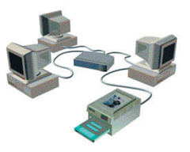
Computer Network Components
A computer network consists of several parts, each part has its own function in the networked system, and these parts are:
Server
Clients
Transmission Media
Network Interface Card
Peripherals
Communication Switches
Network Operating System

Slide 8
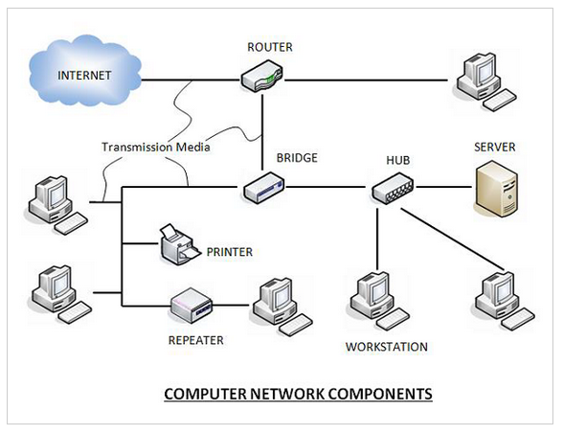

Slide 9
Computer Network Components Cont..
Servers: Servers are computers that hold shared files, programs, and the network operating system. Servers provide access to network resources to all the users of the network. It is characterized by high processing speed and large storage capacity
Clients (Workstations) − Clients are computers that request and receive service from the servers to access and use the network resources.
Transmission media are the channels through which data is transferred from one device to another in a network. Transmission media may be guided media like coaxial cable, fiber optic cables etc; or maybe unguided media like microwaves, infra-red waves etc.

Slide 10
Computer Network Components Cont..
Network Interface Card: each computer in a network has a special expansion card called a network interface card (NIC). The NIC prepares(formats) and sends data, receives data, and controls data flow between the computer and the network.
Peripherals: peripherals are hardware resources provided to the users of the network by servers. Resources provided include printers, scanner, fax,…
Communication Switches: connecting devices act as middleware between networks or computers, by binding the network media together.
Ex: Routers, Hubs, Switches, Repeaters

Slide 11
Computer Network Components Cont..
Network operating system is a program that runs on computers and servers that allows the computers to communicate over the network.

Slide 12
Computer Network Types
A computer network can be categorized by their size. A computer network is mainly of three types:
LAN (Local Area Network)
MAN (Metropolitan Area Network)
WAN (Wide Area Network)

Slide 13
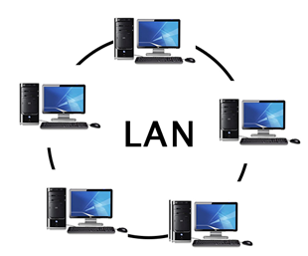
LAN (Local Area Network)
Local Area Network is a group of computers connected to each other in a small area such as building, office.
The data is transferred at an extremely faster rate in Local Area Network.
Local Area Network provides higher security.

Slide 14
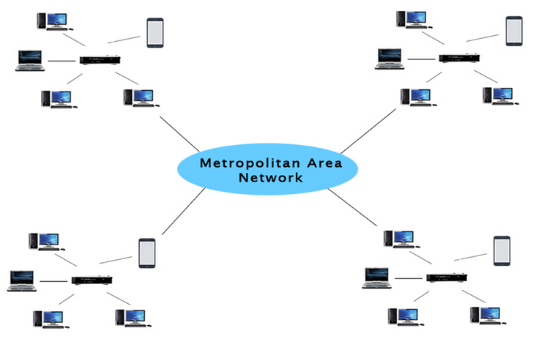
MAN (Metropolitan Area Network)
A MAN is a network that covers a larger geographic area by interconnecting a different LAN to form a larger network.
In MAN, various LANs are connected to each other.
It has a higher range than LAN.

Slide 15
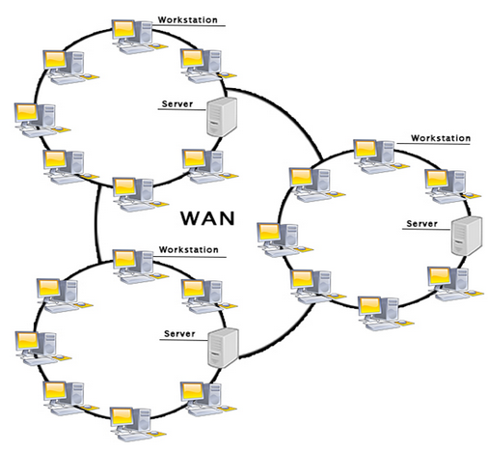
WAN(Wide Area Network)
A Wide Area Network is a network that extends over a large geographical area such as states or countries.
A WAN is quite bigger network than the LAN.
A WAN is not limited to a single location, but it spans over a large geographical area through a telephone line, fiber optic cable or satellite links.
The internet is one of the biggest WAN in the world.
A WAN is widely used in the field of Business, government, and education.

Slide 16
Network Protocols
A network protocol is an established set of rules that determine how:
data is transmitted between different devices in the network.
devices communicate with each other.
send data between different devices .
deal with errors in the network.

Slide 17
Types of Protocols
Transmission Control Protocol (TCP): TCP is a popular communication protocol which is used for communicating over a network. It divides any message into series of packets that are sent from source to destination and there it gets reassembled at the destination.
Internet Protocol (IP): IP is designed explicitly as addressing protocol. It is mostly used with TCP. The IP addresses in packets help in routing them through different nodes in a network until it reaches the destination system

Slide 18
Types of Protocols
File Transfer Protocol (FTP): File Transfer Protocol enables file sharing between hosts. The connection is used to transfer the actual file.
Hyper Text Transfer Protocol (HTTP): HTTP is designed for transferring a hypertext. World Wide Web used HTTP as a request and response type protocol, the client sends a request to the server, which is then processed by the server before sending a response back to the client.

Slide 19
Introduction to Computer Science
Lecture 4_Part2

Slide 20
World Wide Web (www)

Slide 21
World Wide Web
World Wide Web, which is also known as a Web, is a collection of websites or web pages stored in web servers and connected to local computers through the internet.
Websites contain text pages, digital images, audois, videos, etc.
Users can access the content of these sites from any part of the world over the internet using their devices.
The building blocks of the Web are web pages which are formatted in HTML and connected by links called "hypertext" or hyperlinks and accessed by HTTP.

Slide 22
Uniform Resource Locator (URL)
URL is web page address.
A particular collection of web pages that belong to a specific URL is called a website
www.facebook.com, www.google.com
Small websites store all of their WebPages on a single server, but big websites or organizations place their WebPages on different servers in different countries so that when users of a country search their site they could get the information quickly from the nearest server.

Slide 23
Difference between World Wide Web and Internet
Internet It is a worldwide network of devices like computers, laptops, tablets, etc. It enables users to send emails to other users and chat with them online. For example, when you send an email or chatting with someone online, you are using the internet.
But, World Wide Web it is a webpage request from your computer using a browser, and the server Senders that page to your browser.

Slide 24
How the World Wide Web Works
The Web works as per the internet's basic client-server format.
The servers store and transfer web pages or information to user's computers on the network when requested by the users.
A web server is a software program which serves the web pages requested by web users using a browser.
The computer of a user who requests documents from a server is known as a client.
Browser, which is installed on the user' computer, allows users to view the retrieved documents.

Slide 25
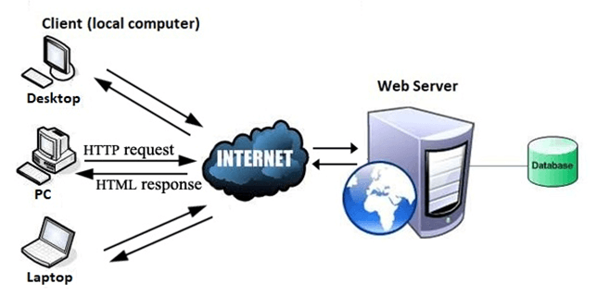
How the World Wide Web Works

Slide 26
Technologies of Transferring Web Pages
The moment you open the browser and type a URL in the address bar or search something on Google, the WWW starts working.
There are three main technologies involved in transferring (web pages) from servers to clients .
Hypertext Markup Language (HTML)
Hypertext Transfer Protocol (HTTP)
Web browsers.

Slide 27
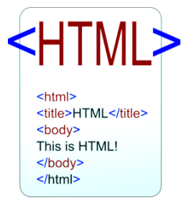
Hypertext Markup Language (HTML)
HTML is a standard markup language which is used for creating web pages.
These language is used to organize the pieces of content such as 'heading,' 'paragraph,' 'table,' 'Image,' and more.
i.e. HTML is used to display text, images, and other resources through a Web browser.

Slide 28
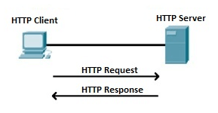
Hypertext Transfer Protocol (HTTP)
Hyper Text Transfer Protocol (HTTP) enables WWW to work smoothly and effectively.
based on a client-server model.
When you enter a URL in the browser, an HTTP command is sent to the Web server, and it transmits the requested Web Page.

Slide 29
Internet, Intranet , and Extranet

Slide 30
Internet
The Internet is a global network of billions of computers and other electronic devices. With the Internet, it's possible to access almost any information, communicate with anyone else in the world, and do much more.

Slide 31
Intranet
An intranet is a private network contained within an enterprise that is used to securely share company information and computing resources among employees.

Slide 32
Intranet Advantages
They let employees easily access important information, links, applications, forms and databases of company records.
A database that includes all the usernames of employees who have access rights to the network is often used to maintain intranet security.
Stores securely document.
knowledge sharing.
Increases internal communication
Connects employees
Automation. Intranets streamline everyday activities by helping to automate repeatable tasks (Increases employee productivity )
Integrates with third-party tools

Slide 33
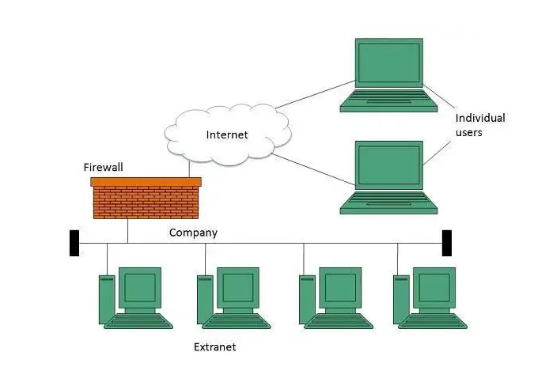
Extranet
An extranet is a private network that enterprises use to provide trusted third parties.
allow to customers, partners, vendors, suppliers and other businesses to gain information, without granting access to the organization's entire network.
Users are selected through user IDs, passwords, and other authentication mechanisms on the login page.

Slide 34
Extranets Advantages
The ability to exchange large volumes of data using electronic data interchange.
Sharing product data or catalogs with business partners.
Sharing services such as online banking applications

Slide 35
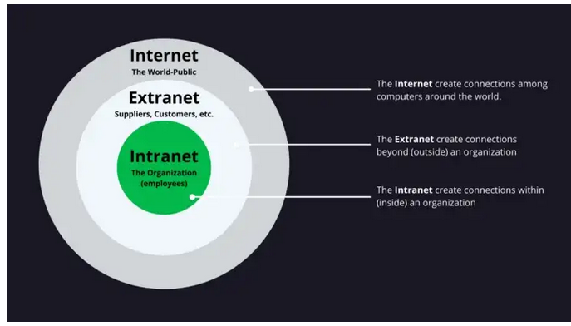
Internet, Intranet, and Extranet

Slide 36
